Slide 1


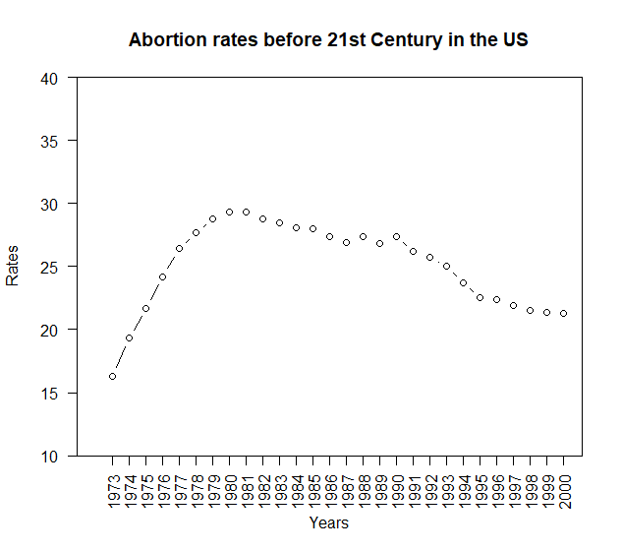
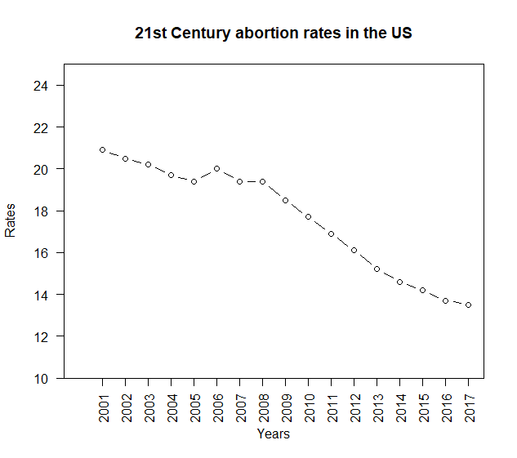
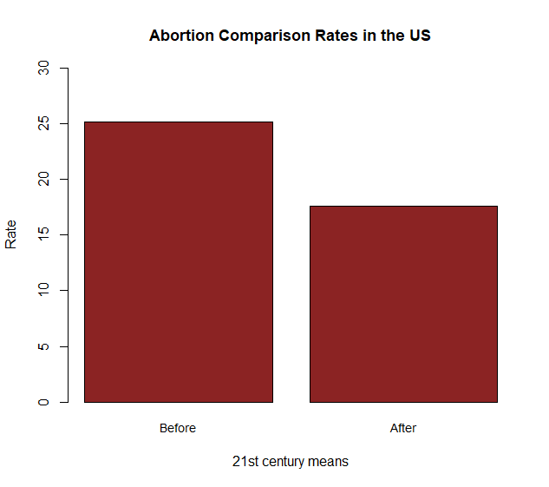
Data Science for Political Science
Abortion Before and After the 21st Century
Tabatha Almonte-Basurco
DATA AND METHODS
RESULTS
ABSTRACT
[COULD DESCRIBE HOW VARIABLES ARE CODED HERE]
Throughout the years, women in the United States have fought for their reproductive rights even though the state and society debated against it. Decades ago, the topic of abortion was taboo until it became more popular and normalized over time in the 2000s.
That is why I believe that the normalization of talking about abortion has made women of the present century more open to sharing their opinions about abortion and therefore more receptive to accepting it, but does it mean that they practice it?
For this reason, I will use data that evaluates reproductive practices in the U.S. before and after the 21st century.
Thanks to the data provided, I could reject my research question and admit that abortion is still practiced but not as much as it was before the 21st century when it was taboo.
DATA
Pregnancies, Births, and Abortions in the United States: National and State Trends by Age, 1973-2017(Guttmacher Institute, 2020)
Data describe historical information on the rate of pregnancy, birth, and abortion among Americans of reproductive age from 1973 to 2017.
912 rows, which each represent a particular state and year in terms of pregnancy, births and abortion from young to 44 year old women.
I use 3 variables in the analysis, which each describe the year, location and abortion rate
abortionratetotal: Abortion rate among women aged 15 to 44
state: State of residence
year: Year
APPROACH
First, I created subsets to group specific information such as location and year. (Before and after the year 2000 (starting year of the 21st century).
Next, created 2 new values looking at a specific column (abortionratetotal) which I used to create scatterplots.
Then, compared both scatterplots
One with values that represents all abortion rates in the U.S. before 2001
One with values that represents all abortion rates in the U.S. after 2001
Finally, used the before-and-after design and analyze it by creating a barplot with both values’ means.
Surprisingly, women of the last century show high abortion rates even though abortion was less well regarded than it is today because it was taboo. (First graph)
Apparently, the explicitness and acceptability of abortion do not lead women in the present century to have abortions. (Second graph)
This suggests that there is a significant impact between past and present-century women when it comes to abortion. However, this is only predictable at first glance.
Used bar plots to compare the difference before and after 2001. (Third graph)
Used the "mean" function to get a total estimate between both periods of time we obtained 25.1 abortion rate before 2001 and 17.6 abortion rate before 2001. (Third graph)
In order to better analyze the barplot, the before-and-after design helped me to define numerically the difference between the two time periods resulting in a 7.5 abortion rate difference between women from the last century and the present.
The evidence from the results answers my research question by rejecting the correlation that exists between the acceptability of abortion in the 21st century with influencing and encouraging women to have abortions.
BACKGROUND
*Research Question. Does the increase of controversy in abortion rights over time influence women to have abortions?
*Importance. This research question is important because it would either feed or disprove the idea that 21st-century women tend to use abortion irresponsibly thanks to its normalization.
Background. Previous scholars have shown that the social context varies according to the present and past century when the topic of abortion is mentioned.
Motherhood and sexual purity was essential in the past (Norris et al., 2011).
Abortion is consider as any other normal topic. No taboo (Sanger, 2017).
*Hypotheses. I hope to test the incongruence that exists between abortion acceptance and the practice of abortion among 21st-century women because I believe there is no correlation between the two statements.
CONCLUSIONS
After analyzing abortion rates among women of all ages in the U.S. from before 2001 to after 2001, I conclude that the acceptability and openness to talk about abortion in the 21st century does not correlate with women being influenced to have an abortion.
This finding turns out to be important so that the acceptance of abortion is not automatically attributed to irresponsible sex but as a right that grants authority and autonomy over women's bodies.
Conversely, women in the last century were shown to have higher abortion rates even though abortion was not openly discussed, resulting in fewer women having abortions because they would be harshly criticized.
Also, this finding could lead to future research by investigating the ratio difference between women who grew up exclusively in the 21st century and who had abortions with women who grew up mostly in the last century and who also had abortions.
Notes:
Feel free to alter the size/names of each section! You can also make the font size smaller and alter locations of sections.

